Slide 1
Semester Project: An Algorithmic Overview
Team Steganasaurus:
Bob O'Neill
George Proctor
Daniel Bostwick
Matt Garnes

Slide 2
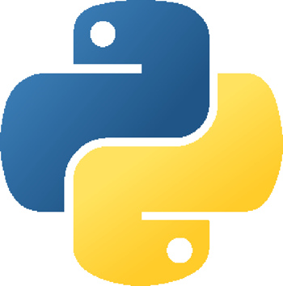
Language and Libraries
Python
NumPy Module
Convenient FFT
Wave Module
Reading/Writing wave data
Reading/Writing header data

Slide 3
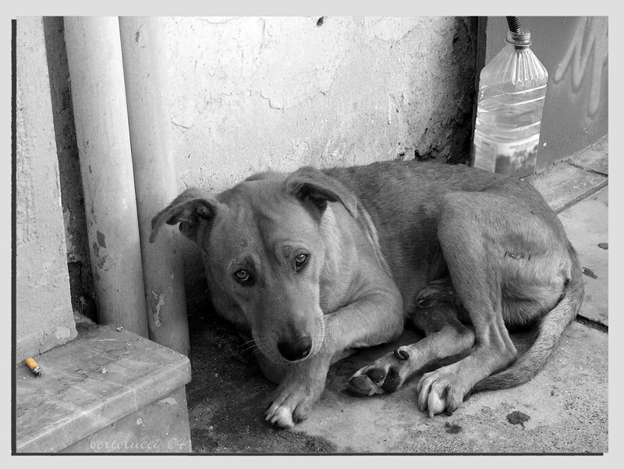
MP3 Conversion Survival
MP3 removes non-audible tones
Insert ”audible” tones to represent bytes
20Hz to 20,000Hz are perceptible
Tones closer to either extreme won't actually be heard ~(20 – 50; 19,000 - 20,000)
Dogs won't like our output
but humans won't know!

Slide 4
Storing Payload Data
Store data by mixing tones with the original audio
First Idea - insert a tone for a 1, skipped for a 0
”Plan to throw one away”
Better Idea – Store tones of different frequencies.
Each frequency represents a byte value
20Hz → 0
21Hz → 1
… 255

Slide 5
Creating a Tone to Insert
Generate a sine wave at a specified frequency for just 4000 samples – 0.1 second
Fade in and fade out the tone
Prevents blips in the audio

Slide 6
Inserting Tones
Find an even spacing based on the size of the payload
At each space, mix the tone (chosen to represent a byte of payload data) with the original audio

Slide 7
Encoded Audio: Steganography
Encoded file size
Mixing tones with original audio → same size
Undetectability
Tones are very high or low – inaudible
Audio sounds the same

Slide 8
Retrieving Payload Data

Slide 9
Finding Frequencies

Slide 10
Assembling the Payload

Slide 11
To Do
Handle both mp3 and wave files as input
Increase accuracy of payload data returned

